Slide 1

Multi Modal Route Planning
Done By :
Anoop Toffy - MT2016016
Harshit Joshi – MT2016059
Mehul Singh – MT2016083
Mohammad Awais - MT2016086

Slide 2
Problem Statement
For a traveler it is often reliable when it comes to use different modes of transport for a single travel whenever it is available. But there lacks efficient systems to find out, even though there are systems that aid traveler to choose different modes of transport, such as Google Transit.
Multimodal Route Planning(MRP) is system that provides the traveller with optimal, feasible and personalized route plan between a given source and destination. The system is designed to provide various public travel approaches (like bus riding, metro travel) and provides traveller the flexibility to choose from different modes of transport.

Slide 3
Related Work
Notes:
A brief overview of the works done by other people so far.Refer papers that we shared in GIT and add a brief overview of the same.

Slide 4
Proposed Solution

Slide 5
Proposed Solution (cont...)

Slide 6
Demo

Slide 7
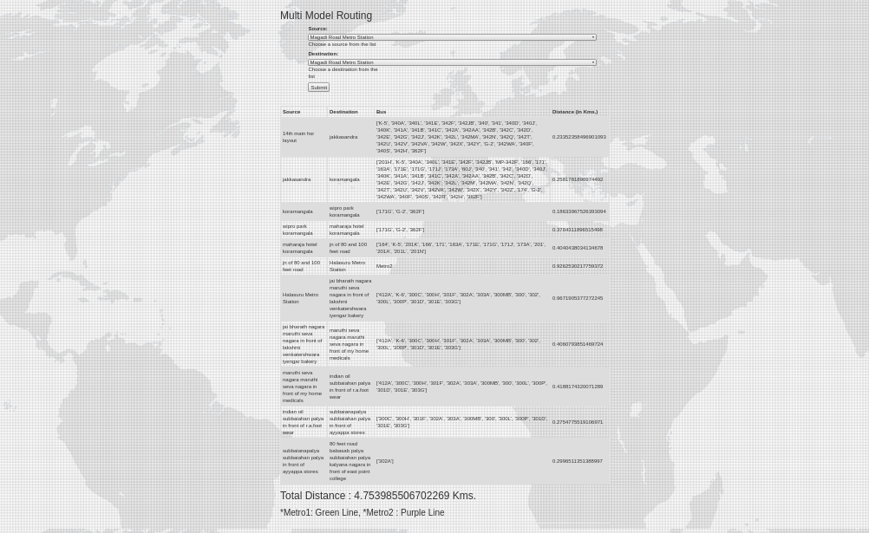
App in Motion

Slide 8
Key Challenges

Slide 9
Future Work

Slide 10
References

Slide 11
Questions ?

Slide 12
Thanks You

